Slide 1
Board of Supervisors Budget Workshop
March 21, 2023
6:00 p.m.

Slide 2

Board of Supervisors Agenda 3/21/23
1. Call to Order
2. Roll Call of Members
3. Welcome and Pledge of Allegiance
4. Approval of Agenda Motion
New Business
a. Presentation of County Administrator’s Proposed Budget
and Capital Improvement Program

Slide 3
Board of Supervisors Agenda 3/21/22
New Business
b. Authorization to Advertise for Public Hearing the County Administrator's Proposed
FY2024 County Budget, the Proposed FY2024-FY2048 Capital Improvement Program,
Proposed School Board FY2024 Budget, and Proposed 2023 Tax Rates
Adjourn to regularly scheduled Board of Supervisors meeting – April 12, 2022

Slide 4
County Administrator’s Recommended Budget
Review of the County’s Budget Process
Priorities and Decision Making Parameters
Budget Recommendation – Operating
Budget Recommendation – Capital
Tax Rates and Public Hearing Requests
Future Challenges and Situational Awareness
Next Steps in the County Budget Process

Slide 5
County Administrator’s Recommended Budget
Review of the County’s Budget Process
October 2022 County Administration prepares budget instruction, estimate forms and department narratives. Instruction and estimate forms are issued to departments and agencies.
January 2023 County Administration, Treasurer, and Commissioner of Revenue prepare revenue estimates. Deadline for submission of budget requests to County Administration.
February 2023 County Administration begins review of budget requests and revenue estimates.

Slide 6
County Administrator’s Recommended Budget
Review of the County’s Budget Process
February 28, 2023 School Board and Board of Supervisors hold joint public budget meeting.
March 7, 2023 Budget Workshop 6 p.m. – General Government, Human Services
March 9, 2023 Budget Workshop 6 p.m. – Public Safety and CIP

Slide 7
County Administrator’s Recommended Budget
Review of the County’s Budget Process & Upcoming Schedule
March 21, 2023 Budget Workshop - Presentation of County Administrator’s Recommended Budget, approval of budget, tax rates, and capital improvement program for publication.
April 11, 2023 Public Hearing on the proposed budget, tax rates, and capital improvement program.
April 18, 2023 Adoption of fiscal year 2023-2024 budget, tax rates, and capital Improvement plan.
Workshop – solar, radio system, and utilities rate study
June 2023 Appropriation of funds for the adopted fiscal year 2023-2024 budget.

Slide 8
County Administrator’s Recommended Budget
Identify Priorities, Constraints, and Decision Making Parameters
Operating budget requests for FY 24 over adopted FY 24 totaled: ~2.4 million
Included increased Schools request of ~$609,000 and ~$1.8 million on County side.
Priorities: Education, Public Safety, Community
Included multiple requests for vehicle replacements, facility improvements, and new positions.
State budget is calling for 5% pay increases for comp board positions and teachers.

Slide 9
County Administrator’s Recommended Budget
Budget Recommendation: The Recommended FY 24 Cumberland County budget is:
A balanced budget with revenues meeting expenditures despite preliminary budget development showing a $2.4 million dollar deficit between projected revenues and expenditures.
No recommended adjustment to the real estate tax rate.
Commissioner of Revenue is recommending collecting personal property at full 100% due to market corrections related to valuation of vehicles and other personal property.
County is assuming a 98% collection rate on real estate and 94-96% on personal property. Neither conservative nor aggressive. Realistic snapshot based on previous year collections averages and consultation with Treasurer and Commissioner of Revenue.

Slide 10

County Administrator’s Recommended Budget
Budget Recommendation: The Recommended FY 24 Cumberland County budget will:
A 5% across the board pay increase for County staff. This will continue to address the salary study related to all County positions.
County absorbs 8.17% increase on employee health insurance.
-Salary survey completed. County has taken proactive measures over the last couple of years to address employee compensation issues.
Current salary survey has indicated a $67,386.81 “gap” in terms of pay, impacting 13 positions.
An ATB increase of 5% will address 40% of the problem, leaving a gap of $37,267.2, impacting 12 positions. Other localities are actively recruiting for positions that are impacted.

Slide 11
County Administrator’s Recommended Budget
Budget Recommendation: The Recommended FY 24 Cumberland County budget will:
Maintain competitiveness of compensation for Public Safety positions.
Fully fund services for Emergency Medical Services and level fund the volunteer fire departments.
Absorbs one time expenditures such as the reassessment contract.

Slide 12
County Administrator’s Recommended Budget
Budget Recommendation: The Recommended FY 24 Cumberland County budget will:
- Meet the County’s funding obligation for the School System.
Will seek to maintain the County’s fund balance at ~$7,000,000 - $8,000,000. This would be the third straight fiscal year of maintaining the fund balance at a healthy level. Well within desired percentage of operating budget – 42.5%
Fund balance to be maintained even with requested use of same rollover funds to balance FY 24 budget and utilized to complete upcoming necessary projects – radio system, courthouse roof, card readers & cameras (as green lighted in September 2022).
Fund a part time Animal Control Officer at mid-year, positively impacting County services.

Slide 13
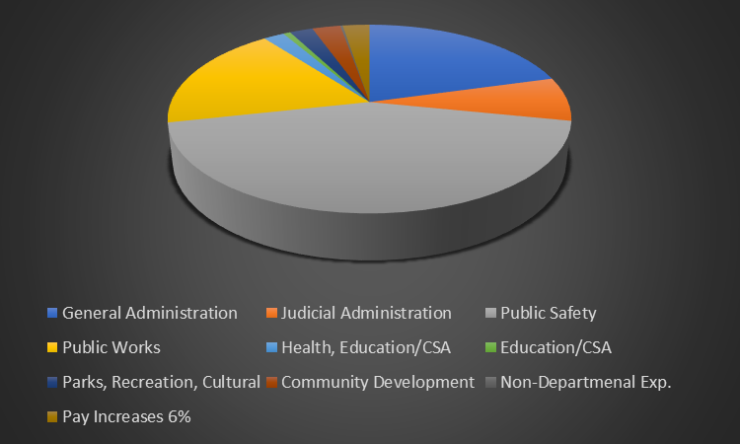
County Administrator’s Recommended Budget
Budget Recommendation – Operating
Cumberland County General Fund Expenditures for FY 2024
General Administration $1,971,164 20%
Judicial Administration $738,546 8%
Public Safety $4,362,020 45%
Public Works $1,791,128 19%
Health $192,039 2%
Education/CSA $24,573 >1%
Parks, Recreation, Cultural $261,426 3%
Community Development $266,810 3%
Non-Departmental Exp. $20,500 >1%
Total Estimated General Fund Expenditures $9,628,205

Slide 14
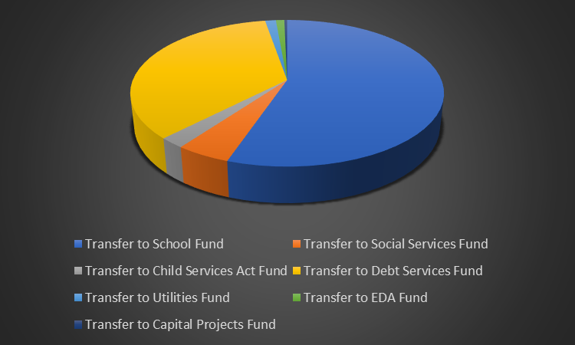
County Administrator’s Recommended Budget
Budget Recommendation – Operating
Cumberland County General Fund Transfers to other Funds FY 24
Transfer to School Fund $4,881,738 53%
Transfer to Social Services Fund $500,136 5%
Transfer to Child Services Act Fund $200,000 2%
Transfer to Debt Services Fund $3,004,638 32%
Transfer to Utilities Fund $218,586 2.3%
Transfer to EDA Fund $107,030 1%
Transfer to Capital Projects Fund $300,000 3%
Total Estimated Transfers $9,212,128
Total Estimated GF Expenditures $9,628,205
Total: $18,840,332

Slide 15
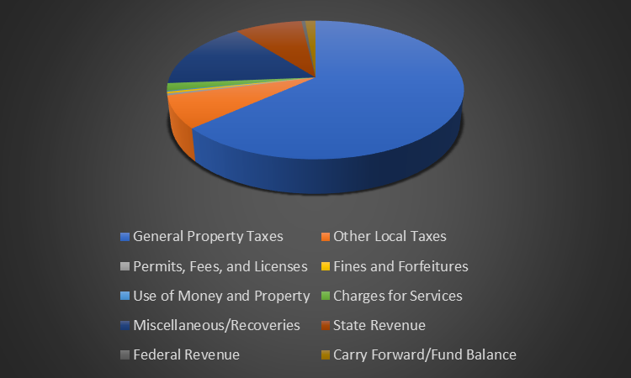
County Administrator’s Recommended Budget
Budget Recommendation – Operating
Cumberland County General Fund Revenue Breakdown- Contingent Upon Receipt of all Federal, State, and Local Revenue.
General Property Taxes $11,309,258 60%
Other Local Taxes $1,445,500 8%
Permits, Fees, and Licenses $381,500 2%
Fines and Forfeitures $80,000 >1%
Use of Money and Property $180,000 >1%
Charges for Services $281,860 1.5%
Miscellaneous/Recoveries $3,260,296 17%
State Revenue $1,729,799 9%
Federal Revenue $172,120 >1%
Total Revenues $18,840,332

Slide 16
County Administrator’s Recommended Budget
Budget Recommendation – 25 Year Capital Improvement Program
76 Total Projects Requested from School and County Staff for next 25 Years
$54,986,000 in funding for all requested projects for next 25 years.

Slide 17
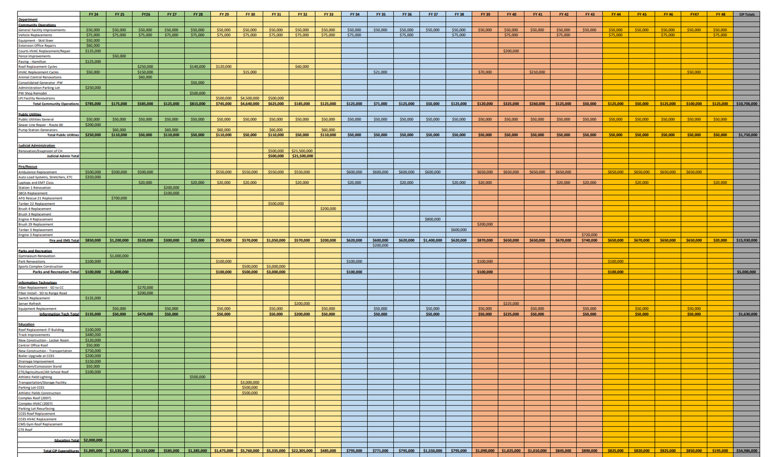

Slide 18
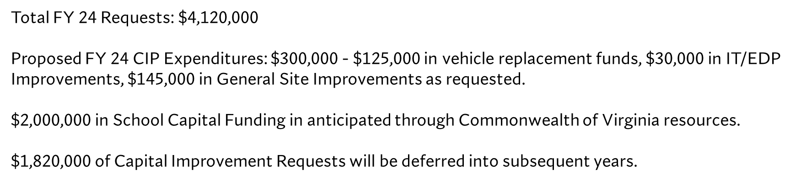
County staff will continue to identify grant funding and other opportunities to help fund CIP Projects.

Slide 19
Total FY 24 Requests: $4,120,000
Proposed FY 24 CIP Expenditures: $300,000 - $125,000 in vehicle replacement funds, $30,000 in IT/EDP Improvements, $145,000 in General Site Improvements as requested.
$2,000,000 in School Capital Funding in anticipated through Commonwealth of Virginia resources.
$1,820,000 of Capital Improvement Requests will be deferred into subsequent years.
Projects funded include: (2) vehicles for Public Works, Administration Parking Lot Improvements, Public Safety Building Improvements.

Slide 20
County Administrator’s Recommended Budget
Tax Rate – Real Estate & Personal Property
The required revenues and expenditures balances are: $18,840,332
This budget was developed utilizing a real estate tax and public service rate of $0.75 per $100 of assessed value and a personal property tax rate of $4.50 per $100 of assessed value.

Slide 21
County Administrator’s Recommended Budget
Minor adjustments may be made to the budget once the state completes their budget process.
Staff will continue to monitor expenses and seek alternative revenue streams to positively benefit the budget.
Staff will continue to monitor capital projects funded with rollover funds to ensure a healthy and positive fund balance.
* Updates will be given throughout the year as to project timelines and costs to aid in recommendations.

Slide 22
County Administrator’s Recommended Budget
Future Challenges, Situational Awareness, & Recommendations:
Purchase and Implement Radio System in FY 24 (2.1 million of cleared debt + fund balance)
Debt Service and Restructuring Opportunities – continue to monitor for opportunities
Monitoring of Composite Index of School System and Future Impacts to County Budgets – this may increase next year.

Slide 23
County Administrator’s Recommended Budget
Future Challenges, Situational Awareness, & Recommendations:
Diversifying County Revenues:
Reassessments in Progress – assessments need to be monitored and balanced approach needed to equalize tax rate versus County needs.
Revisiting County Wide Fee Structure for All Services including Recreation, Utilities and Building Inspections.
Continue to monitor solar and other beneficial economic development projects that could impact the County in the short and long term.

Slide 24
County Administrator’s Recommended Budget
8. Authorization to Advertise for Public Hearing the County Administrator's Proposed
FY2024 County Budget, the Proposed FY2024-FY2048 Capital Improvement Program,
Proposed School Board FY2024 Budget, and Proposed 2023 Tax Rates
Board Action Requested: The Board is requested to authorize staff to advertise the schedule of budgets and tax rates for public hearing on April 11, 2022.

Slide 25
County Administrator’s Recommended Budget
Next Steps
April 11, 2023 - Regular BOS Meeting Public Hearing on the proposed budget, tax rates, and capital improvement program.
April 18, 2023 – Workshop - Adoption of fiscal year 2023-2024 budget, tax rates, and capital Improvement plan. Workshop - Solar, utilities and building inspection fees.
June 2023 - Appropriation of funds for the adopted fiscal year 2023-2024 budget.

Slide 26
County Administrator’s Recommended Budget
Questions?

