Slide 1
Board of Supervisors Meeting
August 8, 2023
7:00 p.m.

Slide 2
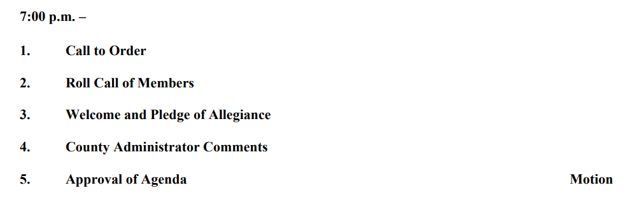

Board of Supervisors Agenda 8/8/23

Slide 3
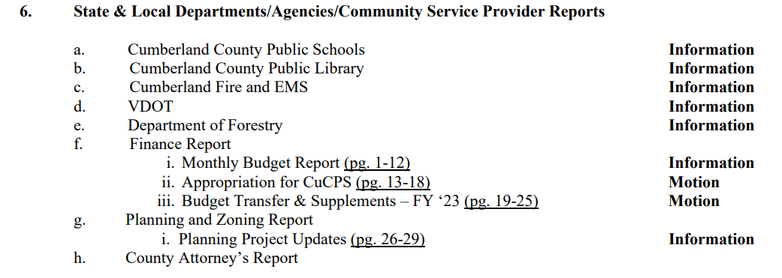
Board of Supervisors Agenda 8/8/23

Slide 4
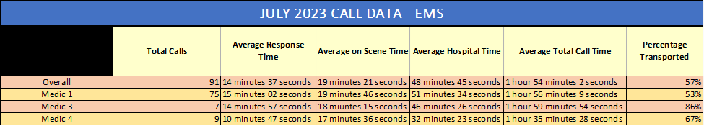
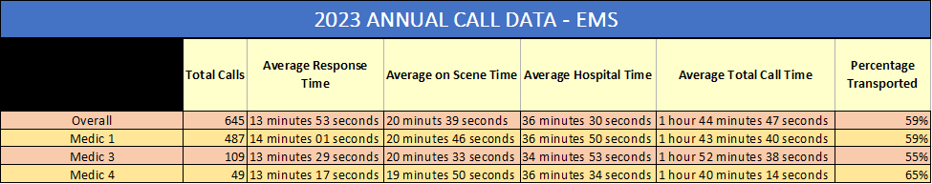
Fire & EMS Report

Slide 5
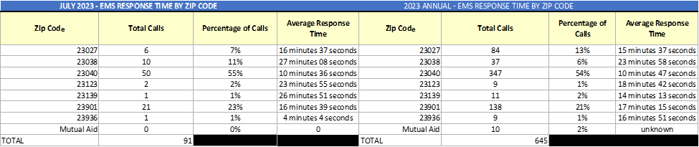
Fire & EMS Report

Slide 6
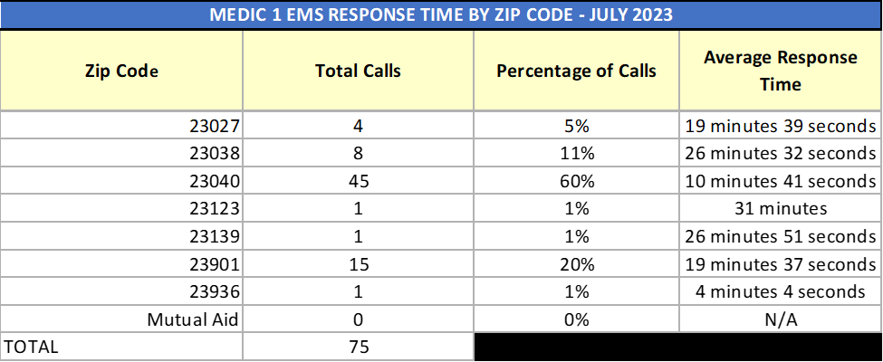
Fire & EMS Report

Slide 7
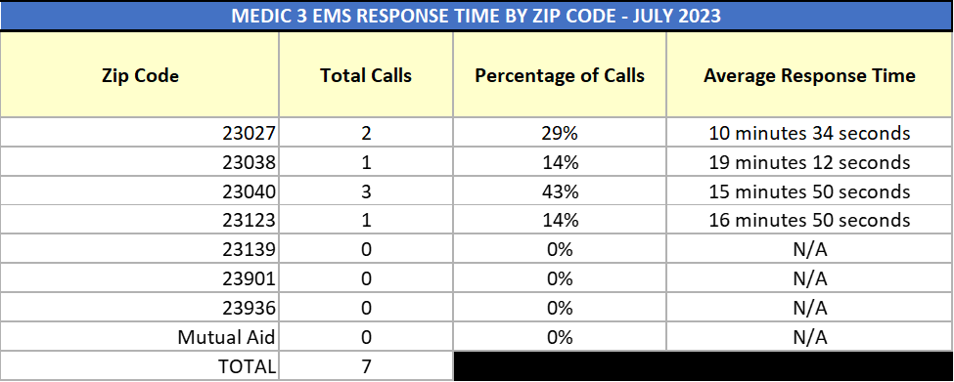
Fire & EMS Report

Slide 8
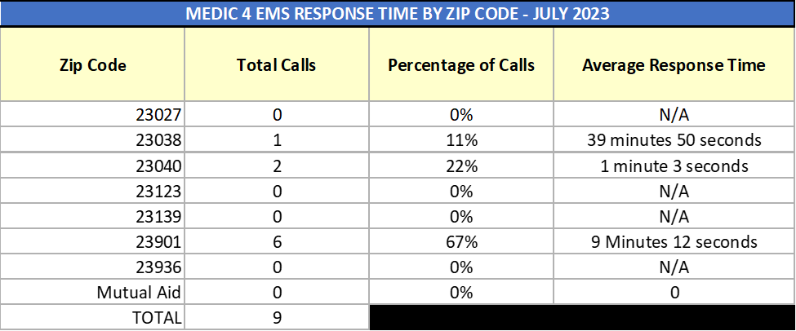
Fire & EMS Report

Slide 9
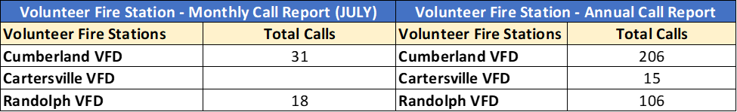
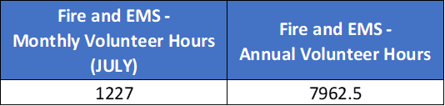
Fire & EMS Report

Slide 10
Fire & EMS Report
Chiefs Meeting Scheduled for August 22, 2023
HOT Weather – partnered with Cumberland Library as cooling location.
Training Update –Emergency Vehicle Operator Course – 9/19, 9/21, and 9/23
Working with the Volunteer Chiefs to set a schedule for the Basic Pump Operator and Rural Water Supply Courses.
The goal:
Once the above classes have been taught within the county, have a county-wide training day that will incorporate all of the philosophies that are taught in these 3 classes.
Get more people released to drive fire and EMS apparatus
CPR (Officially a Health and Safety Institute (HSI) Organization)
Planning – Fire Stations (Volunteers):
September, October, November, and December
Planning – Community Members (Citizens):
Starting first of 2024 and holding at least quarterly maybe more frequent, depending on demand
EMT Class in Prince Edward (Starts in September)
Currently have 5 volunteers signed up to take the class.

Slide 11
Fire & EMS Report
Training Received:
Firefighter 1 – 162 hours (classroom and practical)
This certification is designed to provide trainees with all of the basic knowledge they need about operations and methods on a fire department. This means both theoretical training on strategies and principles in firefighting and practical training with equipment.
Firefighter 2 – 57 total hours (classroom and practical)
Trainees can learn a wider range of operations skills that will help them on a fire scene. This includes further training on fire damage mitigation, how to rescue people from the scene and how to use the best equipment for the job. Trainees will also learn about communication methods and what to do after the fire is out.
Hazardous Materials – Operations – 44 total hours (classroom and practical)
Teaches members how to safely identify a chemical and to how safely operate in a defensive mode (they do not touch the product) on hazardous materials incidents.
Other certifications received:
CPR
NIMS 100, 200, 700, and 800

Slide 12
VDOT Brand Slide

Slide 13
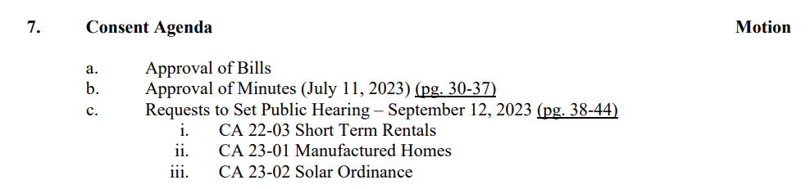
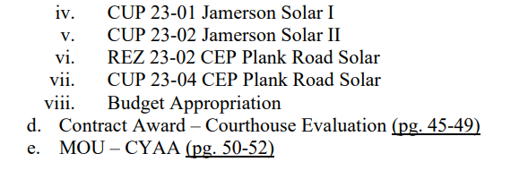
Board of Supervisors Agenda 8/8/23

Slide 14
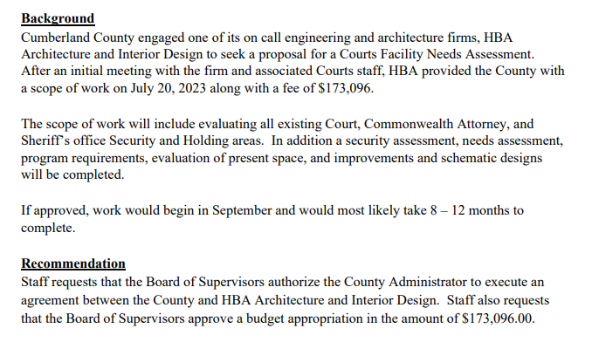
Consent Agenda – Courthouse Analysis

Slide 15
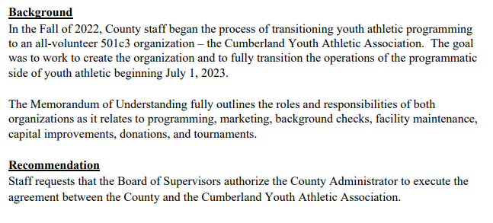
Consent Agenda – MOU CYAA

Slide 16
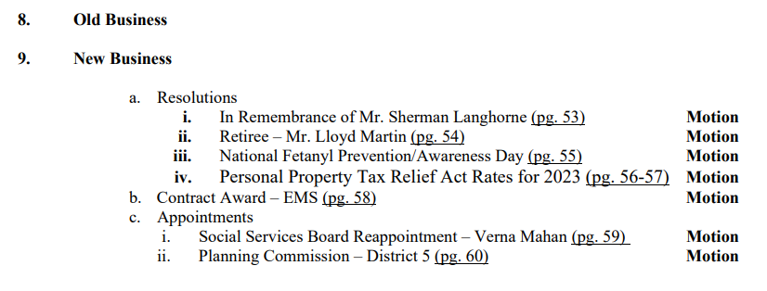
Board of Supervisors Agenda 8/8/23

Slide 17
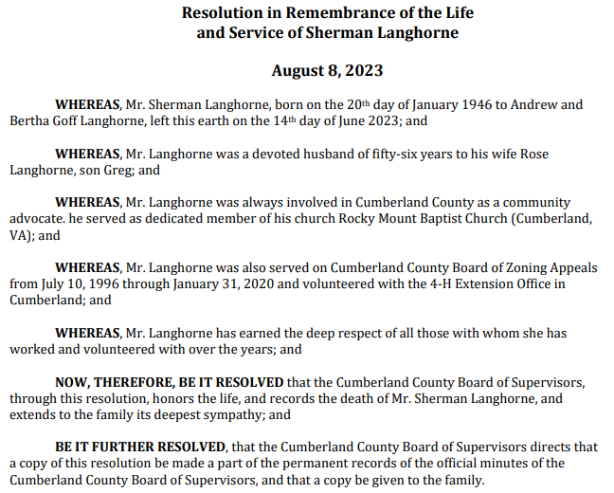
New Business 9 a. i.

Slide 18
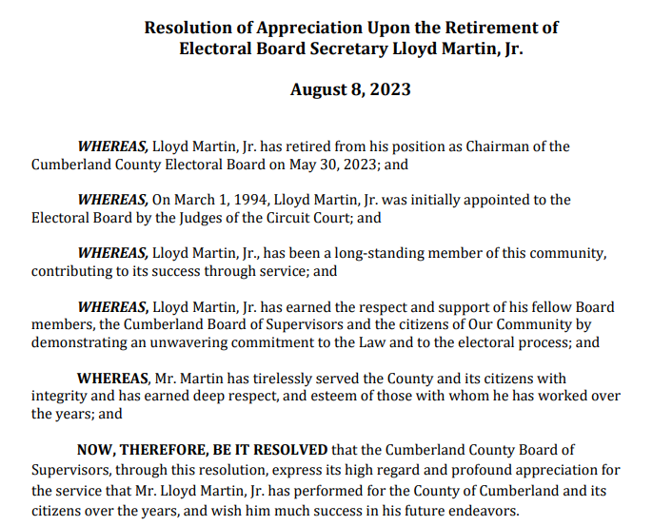
New Business 9. a. ii.

Slide 19
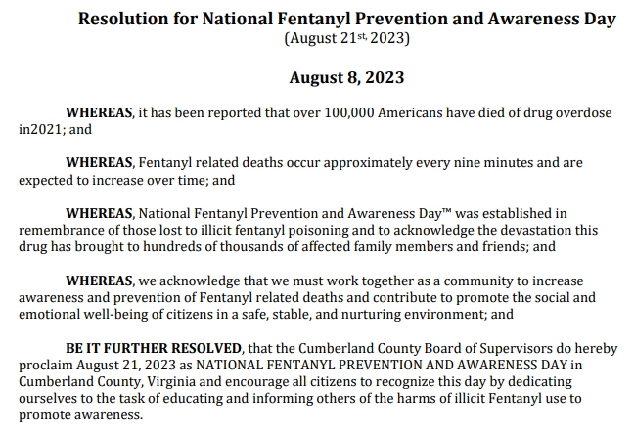
New Business 9. a. iii.

Slide 20
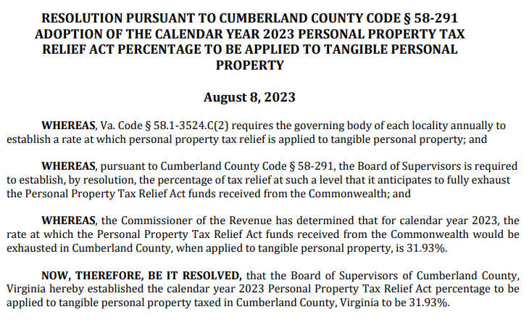
New Business 9.a. iv.

Slide 21
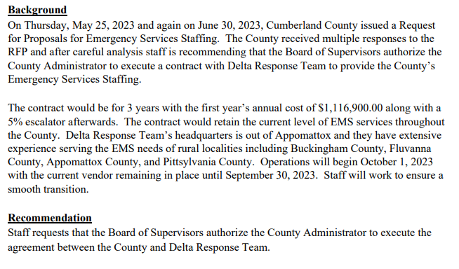
New Business B. Contract Award - EMS

Slide 22

Board of Supervisors Agenda 8/8/23

Slide 23
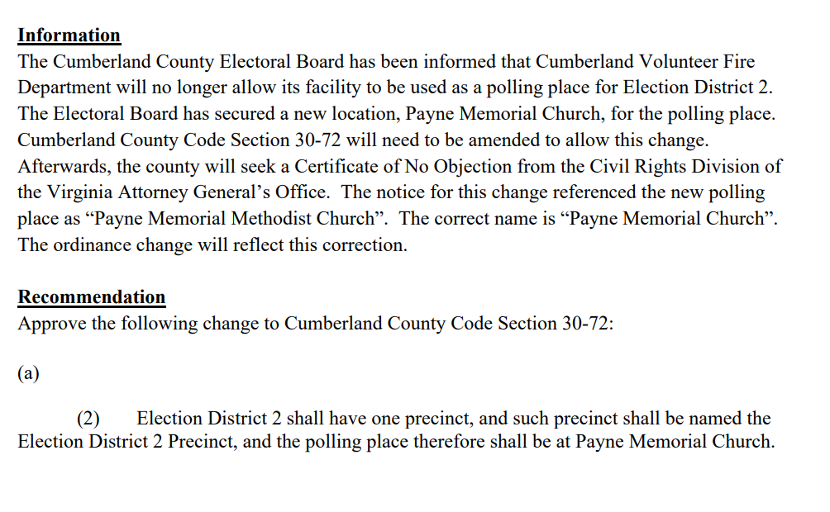
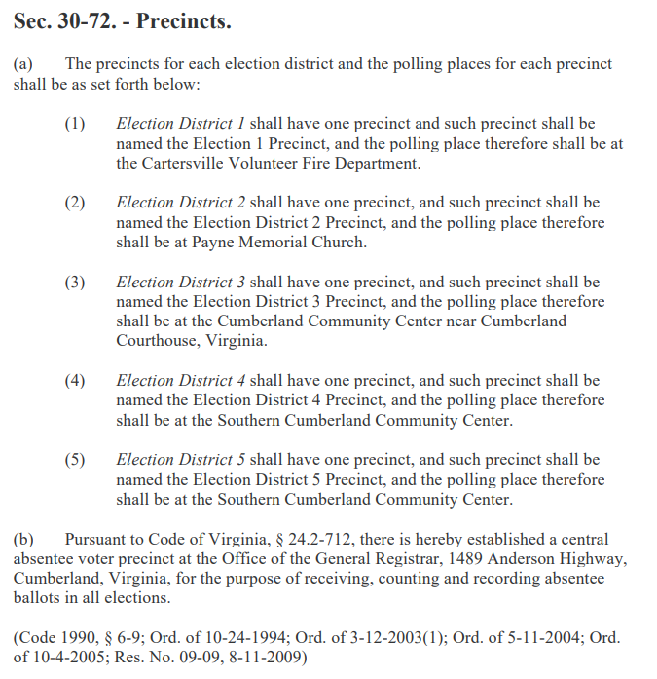
Public Hearing – District 2 Polling Place

Slide 24
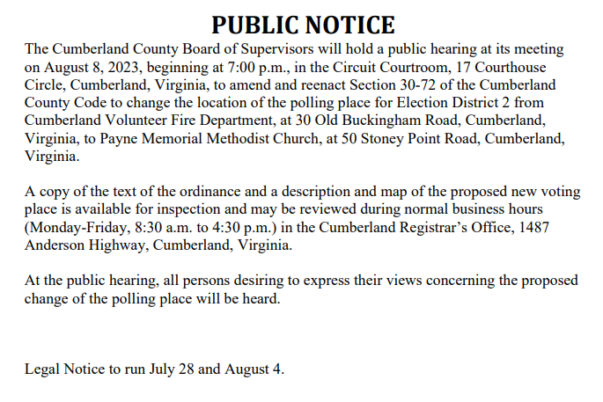
Public Hearing – District 2 Polling Place

Slide 25
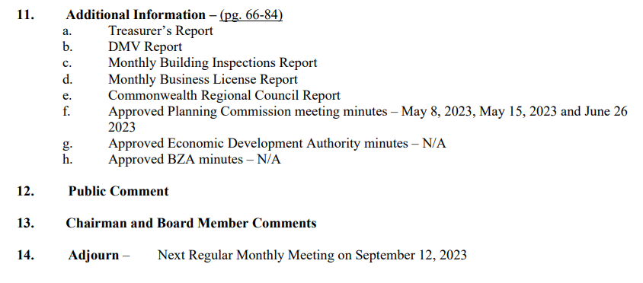
Board of Supervisors Agenda 8/8/23

